Slide 1


Joint Object-Material Category Segmentation from Audio-Visual Cues
Anurag Arnab, michael sapienza, stuart golodetz, Julien valentin, ondrej mikisk, shahram izadi, Philip h.S. Torr
Notes:
Good morning
I am Anurag from the Torr Vision Group at Oxford
I will be talking about our BMVC paper which incorporates audio in semantic segmentation

Slide 2
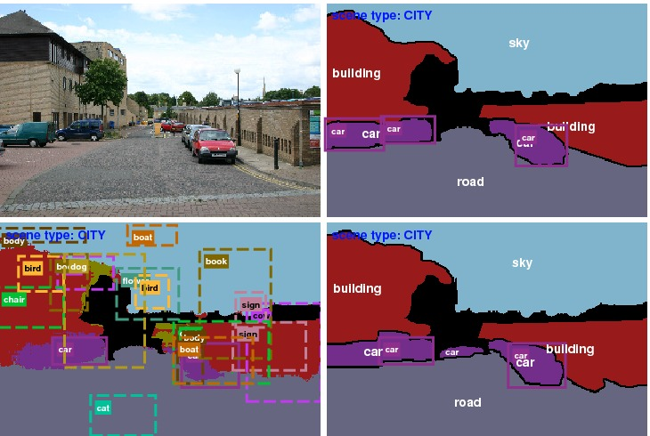
Introduction: Scene Understanding
Long-standing goal of Computer Vision
Encompasses many tasks like object recognition, detection, segmentation and action recognition.
Yao, Fidler, Urtasun. CVPR 2012.
Notes:
Scene understanding is a long-standing goal of Computer Vision. And it encompasses multiple tasks like semantic segmentation (which this talk is about), object detection, counting instances of objects, classifying the scene and so on.

Slide 3

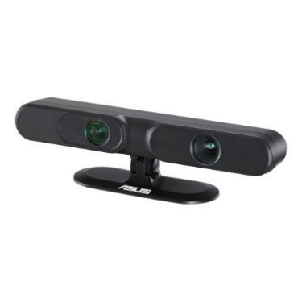
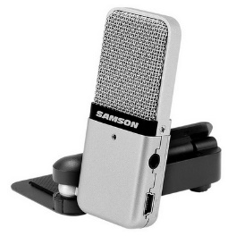
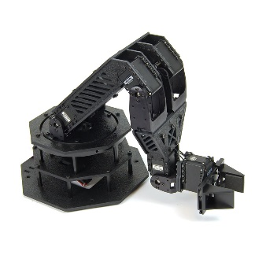
Incorporating additional modalities
Vision community has been focussed on using only visual information for scene understanding.
But we could incorporate other sensory modalities into scene understanding, such as audio
Audio helps disambiguate object classes which are visually similar, but made of different materials
Humans after all, use more than just their dominant sense of sight, for understanding their environment.
Human Senses
Robot Senses
Notes:
The vision community has been focussed on, as you’d expect, visual information for scene understanding, as well as structured models to take into account relationships between different tasks and labels.
However, we can also incorporate other sensory modalities into scene understanding, such as audio.
Additional sensory modalities, such as audio, allows us to disambiguate different object classes which may look visually similar. In particular, audio is really useful for determining material properties.
Moreover, humans use more than just their dominant sense of sight for understanding their environment, so we should probably be doing the same with our robots.

Slide 4
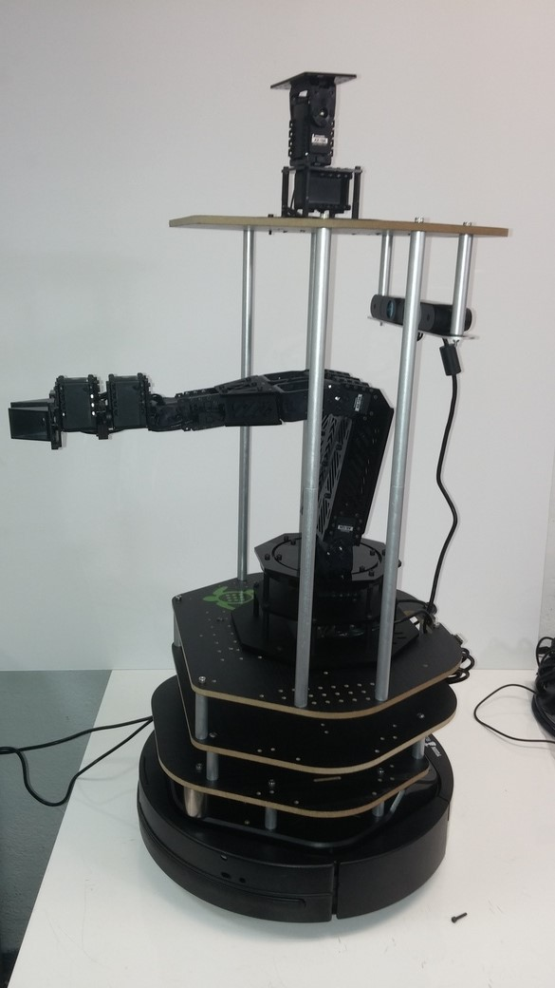
Using auditory information
We envisaged a robot which taps objects in its environment and records the resultant sounds.
The additional auditory information could then be used to refine its existing predictions.
Robot is more “human-like” as it uses multiple senses
Future research direction to use “passive” audio in the environment
Our TurtleBot 2 which unfortunately, arrived too late to be used in this paper. Hence, we collected the sounds manually
Notes:
We initially envisioned a robot which is not only fitted with cameras, but taps objects in its environment and records the resultant sounds.
It can then use this additional information to refine its initial predictions and understanding of the world.
A future research direction is to use “passive audio” from the environment, and by this, we mean sounds which are already in the environment (like oncoming cars). But here, we only focused on “active” sounds obtained from striking objects.
Unfortunately, our robot arrived too late to be used in our paper, and we ended up collecting the sounds manually (by tapping objects with a knuckle)

Slide 5
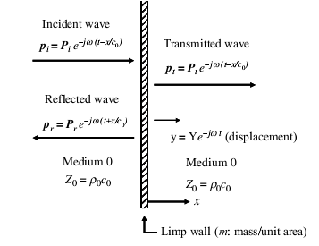
Acoustics
Sound is pressure waves travelling through the air
When an object is struck, particles in the object vibrate. Pressure waves are transmitted through the object, but also reflected.
The object’s density and volume determine reflection and transmission of waves.
Can get acoustic echoes when waves reflect off multiple surfaces.
Sound is very localised
Y Kim. Sound Propagation – An Impedance Based Approach
Notes:
So just some background on acoustics and sound.
Sound is pressure waves that travel through the air.
When an object is struck, particles in the object vibrate. Pressure waves are created and transmitted through the object. They can also be reflected of the surface of the objects.
The object’s density and volume determine the reflection and transmission of waves.
A nuisance factor that we have to deal with is acoustic echoes. We get echoes when sound waves reflect of multiple surfaces and multiple delayed versions of the wave arrive at our microphone. Another is background noise.

Slide 6
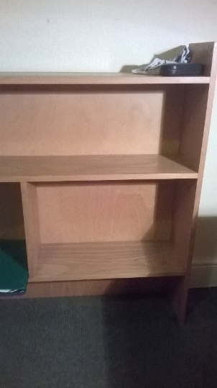
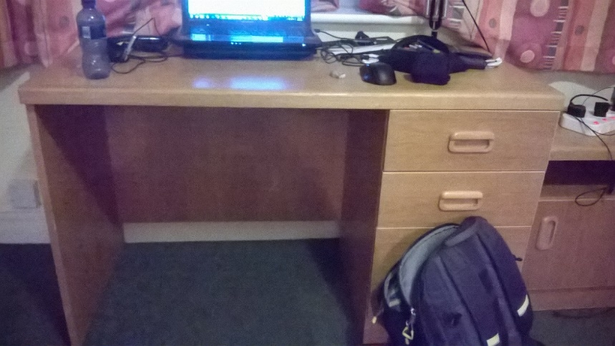
Sound as a Material Property
Sound is a material property since it depends on the density and volume of a material
So we can use sound to improve our recognition of material properties, and then use that to improve our object predictions.
Material properties are also an important attribute of an object, and can also help in fine-grain recognition of objects.
Notes:
The fact that sound depends on the density of the material [as well as its volume] indicates that sound is a property of the material rather than that of the object.
The left leg of the desk in this slide sounds almost the same as the right leg of the bookshelf – I found this out from a nearest-neighbour search in feature space from the sound database that I collected.
So we could use sound to improve our recognition of material properties, and then use this to improve our object category predictions. It does not make sense to directly predict object classes, which is what computer vision techniques are usually interested in
Material properties are also an important attribute of the object, and they are intrinsically useful as they tell us more about the object. Moreover, they could also help in fine-grain recognition of objects.

Slide 7
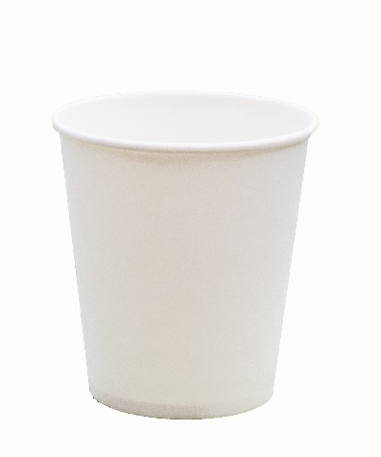
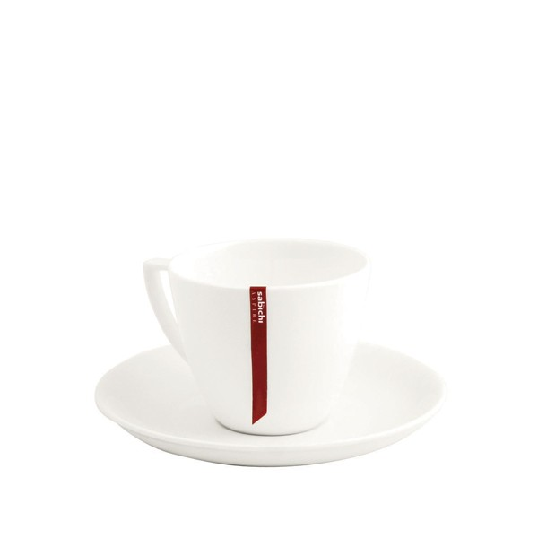
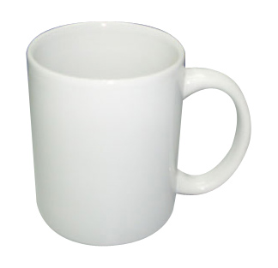
Sound as a Material Property
Sound is a material property since it depends on the density and volume of a material
So we can use sound to improve our recognition of material properties, and then use that to improve our object predictions.
Material properties are also an important attribute of an object, and can also help in fine-grain recognition of objects.
Bone china cup
Porcelain cup
Paper cup
Notes:
Material properties are also an important attribute of the object, and could also help in fine-grain recognition of objects.
So distinguishing these three mugs by visual means alone is almost impossible, but the task is quite simple if you already know the material properties obtained from the sound of the object

Slide 8
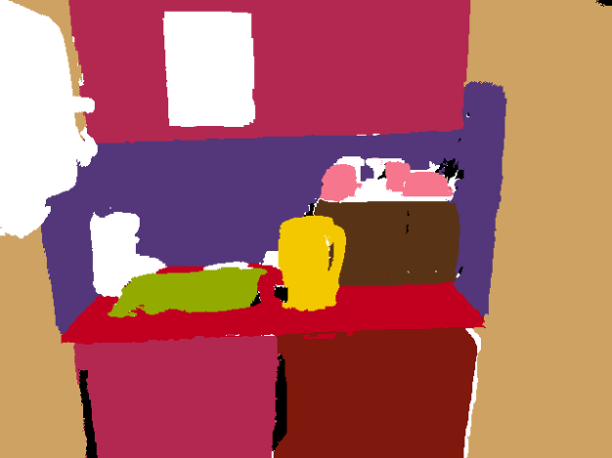
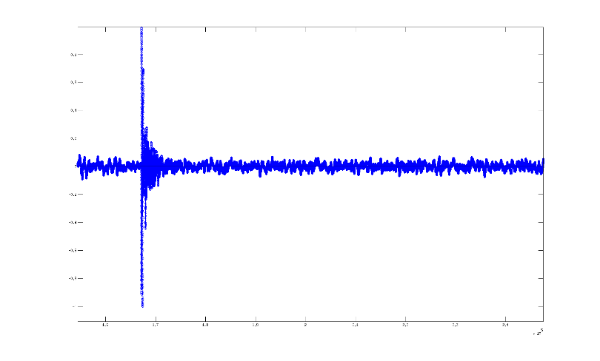
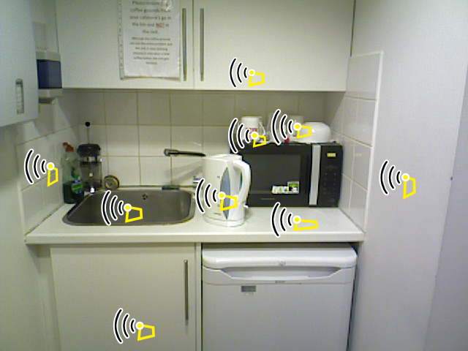
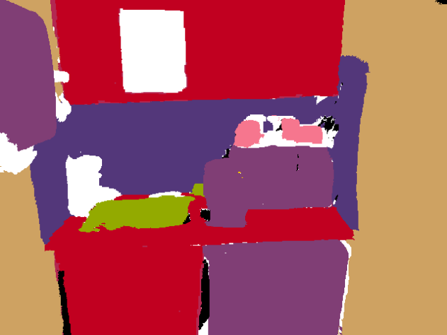
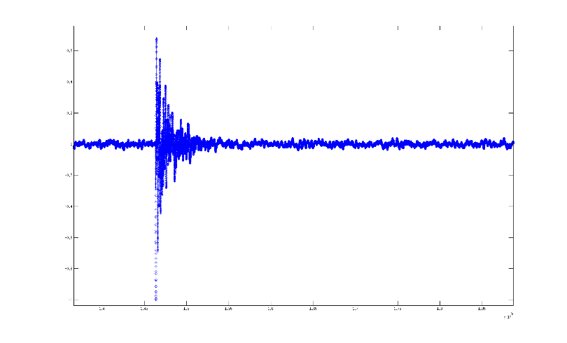
Dataset
Create our own since no dataset combines labelled audio and visual data.
574 Train-Val, 214 Test images. 406 Train-Val, 203 Test sounds.
Cupboard
Dense
object category labels
Tile
Input image
Microwave
Sink
Kettle
Fridge
Wall
Dense
material category labels
Tile
Ceramic
Steel
Wood
Plastic
Gypsum
Dataset available at: www.robots.ox.ac.uk/~tvg/projects/AudioVisual/
Notes:
So we had to create our own dataset for this project, since there is no dataset which combines labelled audio and visual data. There are datasets like Pascal and MSRC which have dense semantic labels, but they do not have any sound associated with those objects.
As a result, we annotated dense object category labels and material category labels. We also collected audio waveforms and marked on the images where the objects were struck in order to associate sound information with image pixels.
Note that sound obtained from tapping objects is very localised, and hence most pixels don’t have any auditory information associated with them. This also makes inference using vision and sound more challenging.

Slide 9
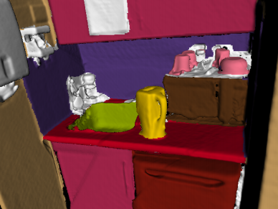
Dataset creation using SemanticPaint
Created 3D reconstruction of a scene, and annotated this.
Approximate location of where the object was hit was annotated in the 3D reconstruction.
This ensures consistency of “sound localisation” throughout many viewpoints
Also accelerates labelling.
More details: www.semantic-paint.com
Golodetz, Sapienza et al. SIGGRAPH 2015
Notes:
This dataset creation and annotation would have been very labour intensive had it not been for our interactive 3D reconstruction and annotation tool, Semantic Paint.
Michael will explain the details of this system, but we used a sequence of depth images from an RGB-D camera and the Semantic Paint pipeline to create a 3D reconstruction of a scene. These scene was then annotated in 3D with object and material labels. Furthermore, the approximate location of where the object was hit was also annotated in the 3D reconstruction.
We label the entire reconstructed scene once, and then raycast the reconstruction from different viewpoints to get annotated 2D images. This significantly speeds up the labelling process, since a reconstruction can be labelled in about an hour. From this kitchen scene for example, we used 2500 images to create the reconstruction, and after annotation, we sampled 150 images since many of the images were similar.
Another important feature of this labelling method, is that it ensures that we consistently annotate the region which an object was struck to obtain sounds, from many different viewpoints.

Slide 10
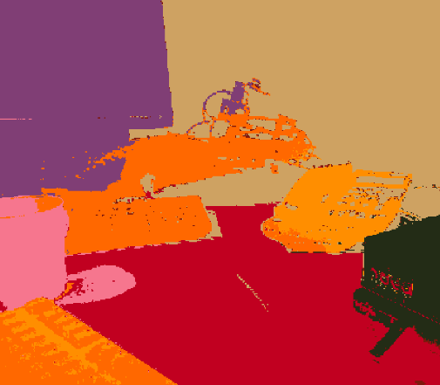
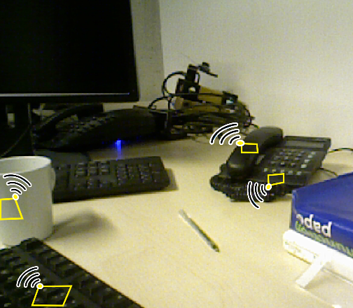
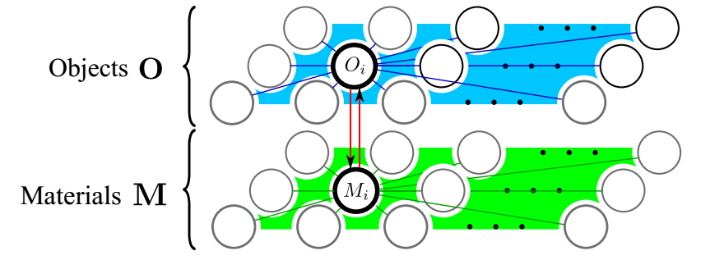
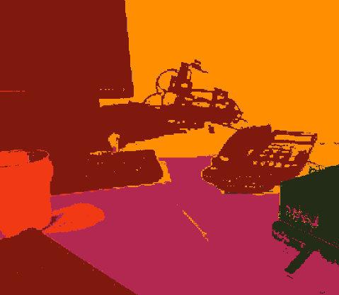
Pipeline
Input
Output
Visual Classifier
Per-pixel probabilistic object prediction
CRF
Object labelling
Audio Classifier
Per-pixel probabilistic material prediction
Per-pixel probabilistic material prediction
Material labelling
Notes:
Our pipeline for recognition is then as follows:
The input is an RGB image, as well as auditory information associated with a small subset of the image pixels.
The entire RGB image is input to a Visual Classifier which produces per-pixel probabilistic predictions for the object class as well as the material class.
The different sound waveforms are input to an Audio Classifier which produces probabilistic material predictions. These predictions are then associated with the pixels which the sound was obtained from.
These probabilistric predictions then act as the unary potentials of our bi-layer, joint Conditional Random Field. We use this structured model to refine our noisy unary predictions and produce object and material labels which are consistent with each other and image boundaries.

Slide 11

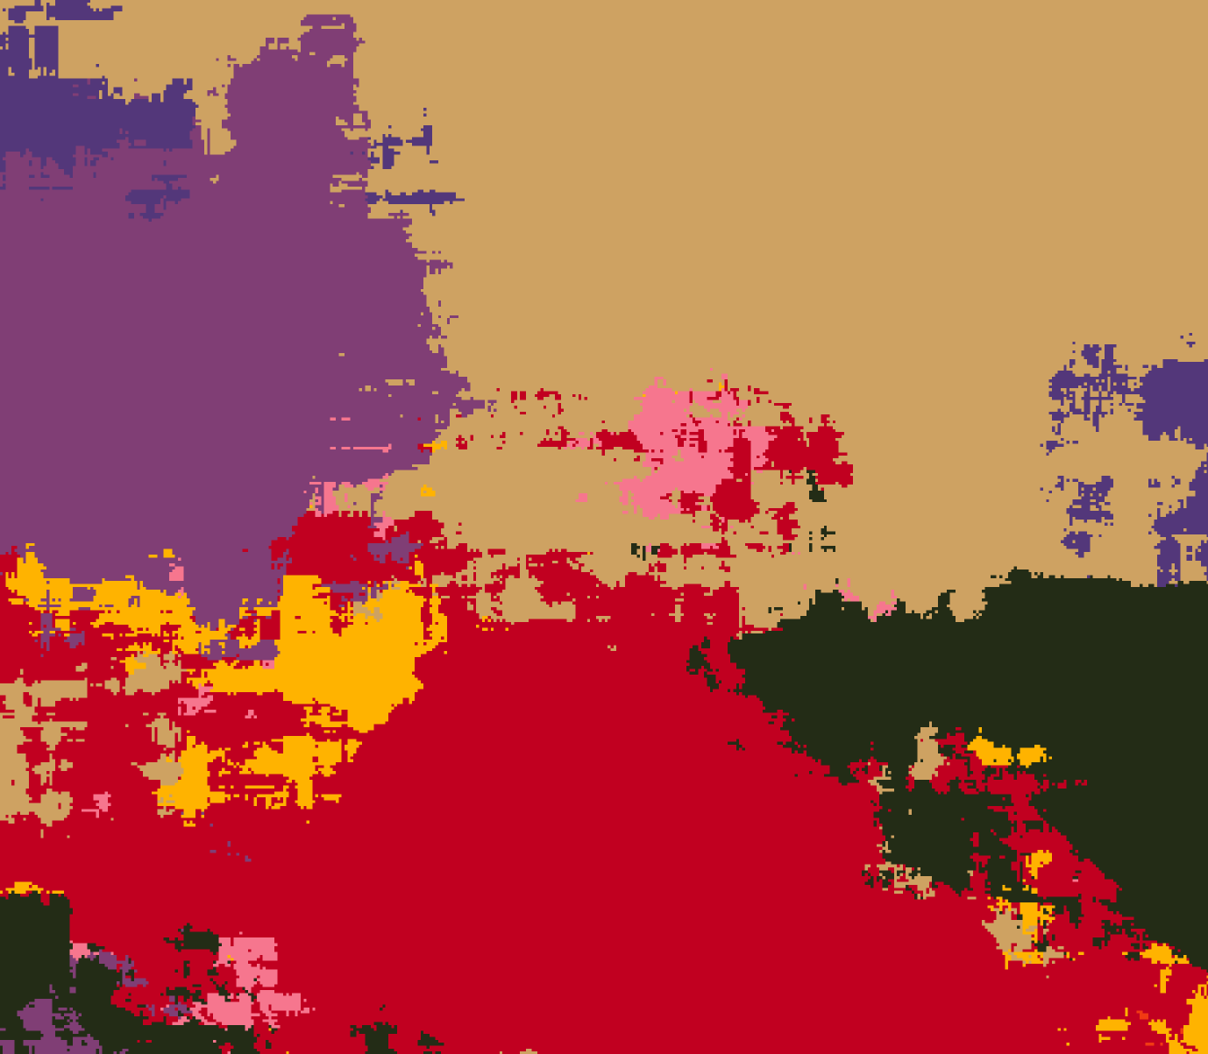
Visual Classifier
Joint-Boosting classifier
Features:
SIFT, HOG, LBP, colour
Results are very noisy since the prediction of each pixel is based only considering other pixels in a neighbourhood
Input
Noisy object unary
Notes:
Our visual classifier is a Joint-Boosting classifier that uses hand-crafted features: SIFT, HOG, LBP and colour, quantised with bag-of-words.
For every pixel, we examine a window around it from which we extract these features, and then we classify the pixel using this.
There is no global context from this method, since the prediction of each pixel is based by only examining its immediate neighbourhood. This often gives us predictions which are noisy and not consistent with edges in the image. But our CRF later in the pipeline ameliorates this issue.
We would have used a CNN if we had a larger dataset, as that would probably have given us better unary potentials.

Slide 12
Audio Classifier
Isolate the sound from the recording
Extract features
Classify with random forest
Notes:
Our audio classifier first isolates the sound of interest from a recording, extracts features and then classifies these features with a random forest

Slide 13
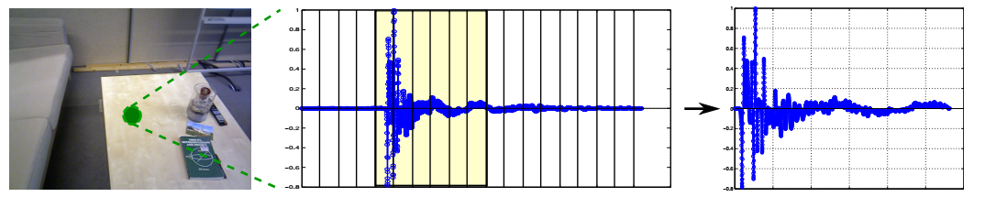
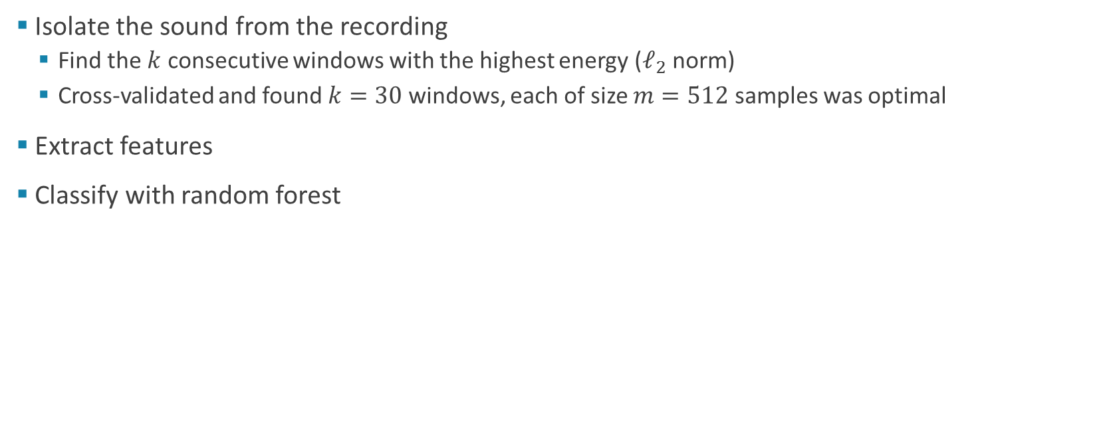
Audio Classifier
Isolate the sound from the recording
Find the $k$ consecutive windows with the highest energy ($ℓ_{2}$ norm)
Cross-validated and found $k=30$ windows, each of size $m=512$ samples was optimal
Extract features
Classify with random forest
Notes:
This image shows an example of a waveform obtained from striking a table.
As you can see, there is a period of silence before the object is struck and the sound dies down after that as well.
To isolate this sound, we divide the recording into windows of size m, and then select the k consecutive windows with the highest energy (or l2 norm)
This is based on the assumption that the sound of interest initially has the highest amplitude in the recording, and then decays over time. This is true when there is not much background noise
And by cross-validating, we found that 30 consecutive windows with 512 samples per window worked the best.

Slide 14
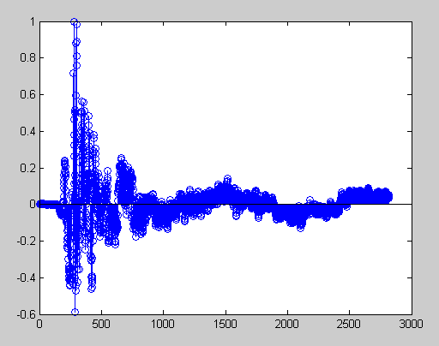
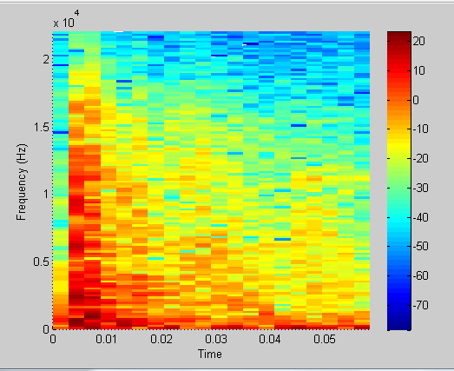
Audio Classifier
Isolate the sound from the recording
Extract features
Features based in time-domain and also from the Short-Time Fourier Transform (STFT) of the windowed signal
Refer to paper and [1,2,3] for details
Classify with random forest
[1] Giannakopoulos et al, 2010. [2] Giannakopoulos et al , 2007. [3] Antonacci et al, 2009.
Notes:
From the isolated sound, we then extract features for classification.
We use features from the time domain (such as the energy per window) and also the frequency domain by computing the Short-Time Fourier Transform of the windowed signals (Hamming window). Different statistics were computed from the frequency domain and used as features
All these features were then concatenated together and classified with a random forest (which was just chosen as it performed better than an SVM or Boosting).
We did not take any other steps to combat acoustic echoes, but recordings with echoes and speech in the background in our test set were not particularly problematic.

Slide 15
Conditional Random Field (CRF)
Bilayer conditional random field has smoothness priors (colour and spatial consistency) which smoothes the noisy predictions of the unary classifiers.
Jointly optimises for objects and material labels, to ensure consistency between the two (a desk cannot be made of ceramic and so on).
Notes:
The output of our classifiers act as the unary potentials of our conditional random field, or CRF.
Our CRF has smoothness priors which encourage pixels of the same colour to take the same label, and also nearby pixels to take the same labels.
Our CRF consists of two levels, one for object labels and one for material labels. Connections between the two categories are used to ensure consistency between the two: for example, a desk cannot be made from ceramic and so on.

Slide 16
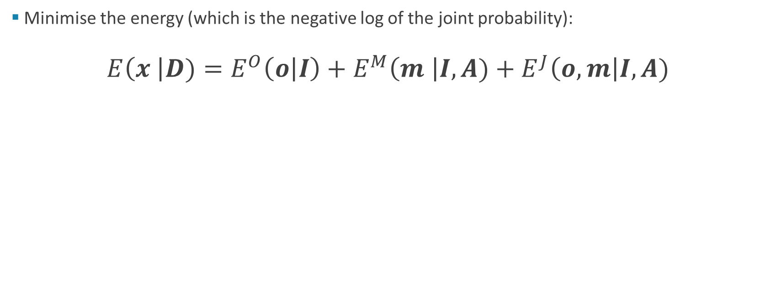
Conditional Random Field (CRF)
Minimise the energy (which is the negative log of the joint probability):
$$E\left(x \right|D)=E^{O}\left(o | I\right)+E^{M}\left(m \right|I,A)+E^{J}\left(o,m\right|I,A)$$
Energy in object layer
Energy in material layer
Joint energy
Notes:
A CRF defines a probability distribution (actually a Gibbs distribution) where the probability of a node depends on its observed data (which is not shown in this figure), as well as connections between other nodes in the graph.
My taking the negative logarithm of the probability, we obtain an energy function. Minimising this energy function corresponds to finding the MAP or Maximum a Posteriori labelling.
Our energy consists of an object energy, which is obtained from all the nodes in the Object layer of the CRF; a material energy computed from all the nodes in the Material layer of the CRF; and a joint energy obtained from links between the object and material nodes. I will now describe each of these energies.

Slide 17
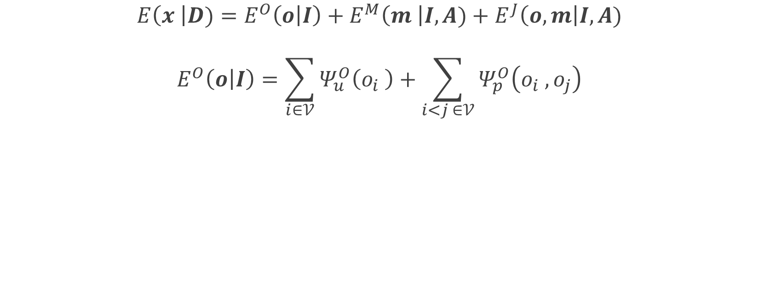
Object Energy
$$E\left(x \right|D)=E^{O}\left(o | I\right)+E^{M}\left(m \right|I,A)+E^{J}\left(o,m\right|I,A)$$
$$E^{O}\left(o | I\right)=\sum_{i∈𝒱}{Ψ_{u}^{O}\left(o_{i} \right)+\sum_{i<j ∈𝒱}{Ψ_{p}^{O}\left(o_{i} , o_{j}\right)}}$$
Unary cost from
Boosting classifier
Pairwise cost encouraging colour and spatial consistency
$$Ψ_{p}^{O}\left(o_{i} , o_{j}\right)=w_{1}exp\left(−\frac{| p_{i} −p_{j}|^{2}}{2σ_{α}^{2}}−\frac{| I_{i} −I_{j}|^{2}}{2σ_{β}^{2}} \right)+w_{2}exp\left(−\frac{| p_{i} −p_{j}|^{2}}{2σ_{γ}^{2}} \right) [1]$$
[1] Krahenbuhl and Koltun, NIPS 2011.
Notes:
The object energy consists of a unary cost from the visual boosting classifier. Each node in the CRF graph corresponds to a pixel in the image, and the unary cost for each label and each pixel is the negative logarithm of the probability predicted by the classifier for that class.
The object nodes are then densely connected to each other with a pairwise cost which encourages colour and spatial consistency. By densely connected, I mean that evey node is connected to every other node. We used the same Gaussian-kernel pairwise potentials as Krahenbuhl and Koltun, since they can be optimised for very fast mean-field inference.
We could have used higher order terms (by this I mean cliques in our graph consisting of more than two nodes), but in practice, we found that they did not really improve results

Slide 18

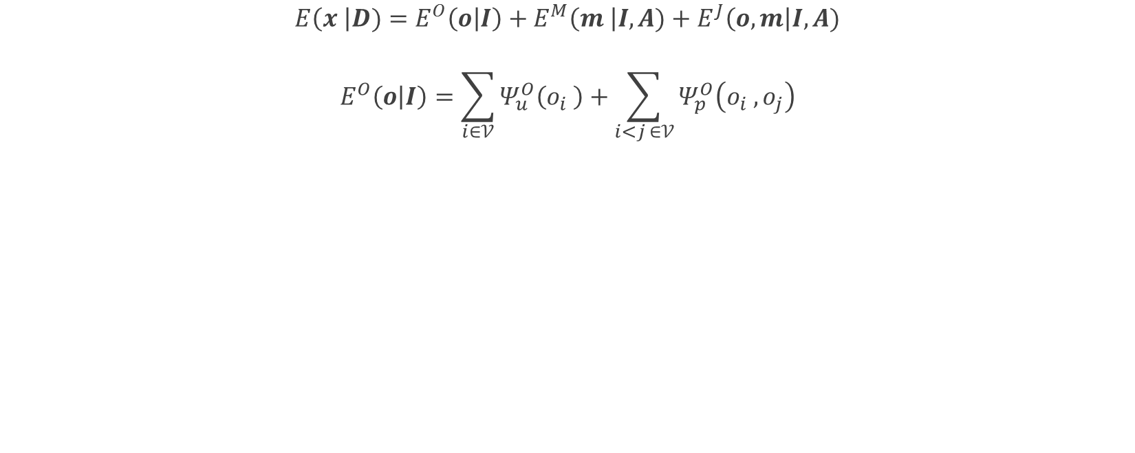
Object Energy
$$E\left(x \right|D)=E^{O}\left(o | I\right)+E^{M}\left(m \right|I,A)+E^{J}\left(o,m\right|I,A)$$
$$E^{O}\left(o | I\right)=\sum_{i∈𝒱}{Ψ_{u}^{O}\left(o_{i} \right)+\sum_{i<j ∈𝒱}{Ψ_{p}^{O}\left(o_{i} , o_{j}\right)}}$$
Input
Unary
Unary + Pairwise
Example:
Notes:
So here is an example of this energy function in use.
Initially, the predictions of our unary classifier are very noisy, as each pixel is predicted using very local information. However, when we incorporate our pairwise potentials, the results are much smoother and more consistent. There are still some clear failures in the output, such as the mug which was not segmented – possibly because it is similar to the wall in its white colour and lack of texture.

Slide 19
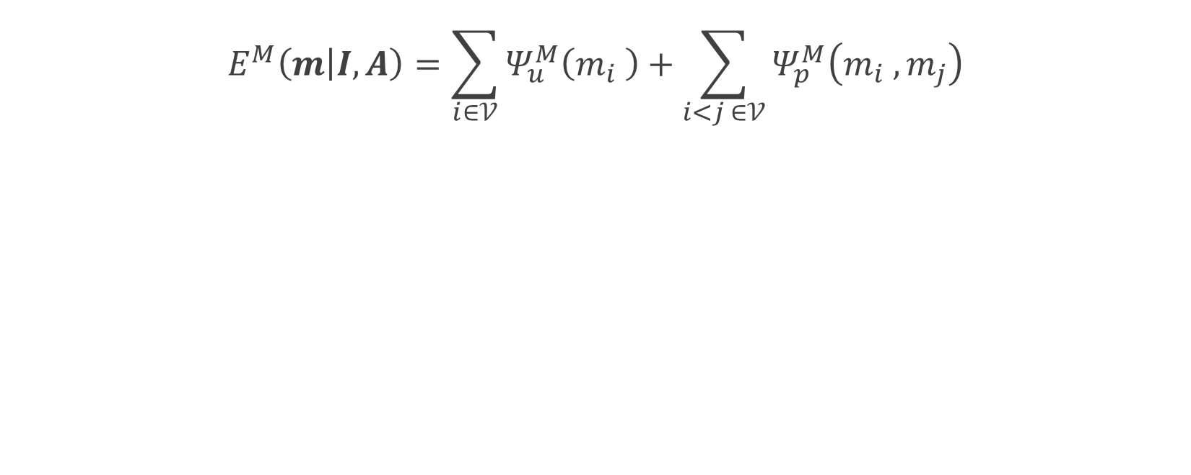
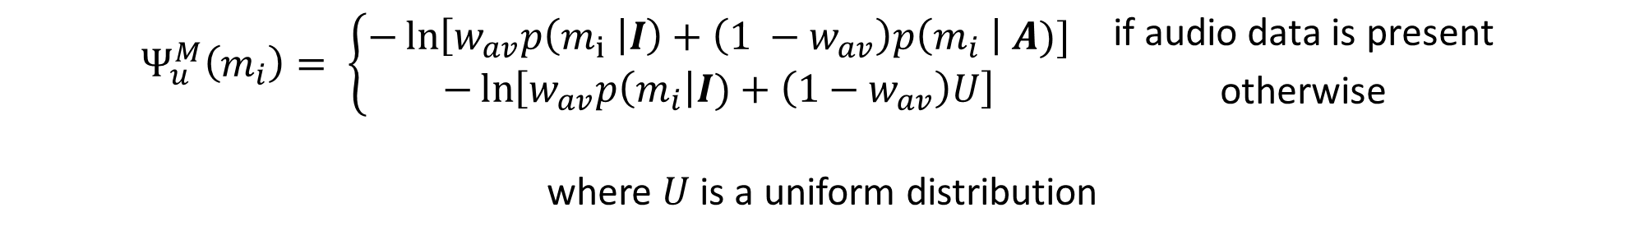
Material Energy
$$E^{M}\left(m | I,A\right)=\sum_{i∈𝒱}{Ψ_{u}^{M}\left(m_{i} \right)+\sum_{i<j ∈𝒱}{Ψ_{p}^{M}\left(m_{i} , m_{j}\right)}}$$
Combination of unary costs from classifiers
Same form as objects
$$Ψ_{u}^{M}\left(m_{i}\right)= \left\{\begin{aligned}−\ln\left[w_{av}p\left(m_{i} \right|I\right)+\left(1 −w_{av}\right)p\left(m_{i} \right| A)] \\ −\ln\left[w_{av}p\left(m_{i}\right|I)+\left(1−w_{av}\right)U\right] \end{aligned}\right. {\text{if} \text{audio} \text{data} \text{is} \text{present} \atop \text{otherwise}}$$
where $U$ is a uniform distribution
Notes:
The material energy is also a sum of unary and pairwise potentials. The pairwise potentials are of the same form as the objects, and so I will not describe them again.
The unary energy (or cost) is different since we have two classifiers for materials – a classifier which operates on visual features and another one from sound features. Furthermore, we only have auditory information for a small number of pixels.
So when we do have auditory information, the unary cost is the negative logarithm of a convex combination of the probabilities output by the visual classifier and audio classifier respectively.
In the case that we do not have auditory information, we assume that the output of the sound classifier is a Uniform distribution. In other words, all material categories are equally likely

Slide 20

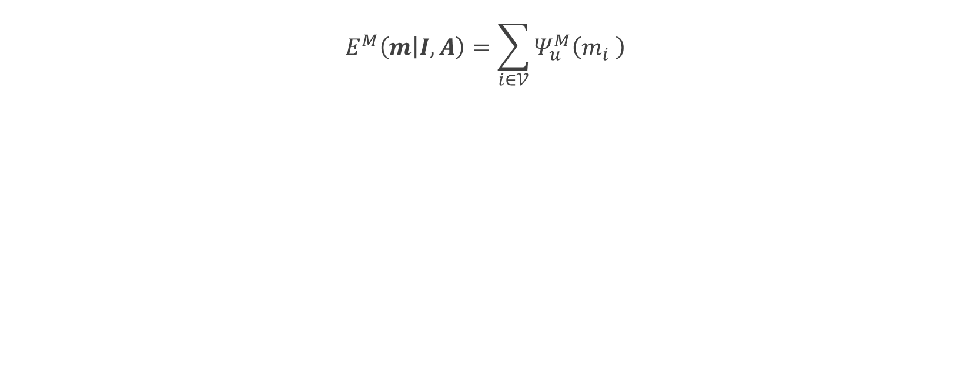
Material Energy
$$E^{M}\left(m | I,A\right)=\sum_{i∈𝒱}{Ψ_{u}^{M}\left(m_{i} \right)}$$
Input
Unary
Notes:
So here, we can again see that our unary predictions are quite noisy. We are only showing the unary predictions from our visual classifier.

Slide 21
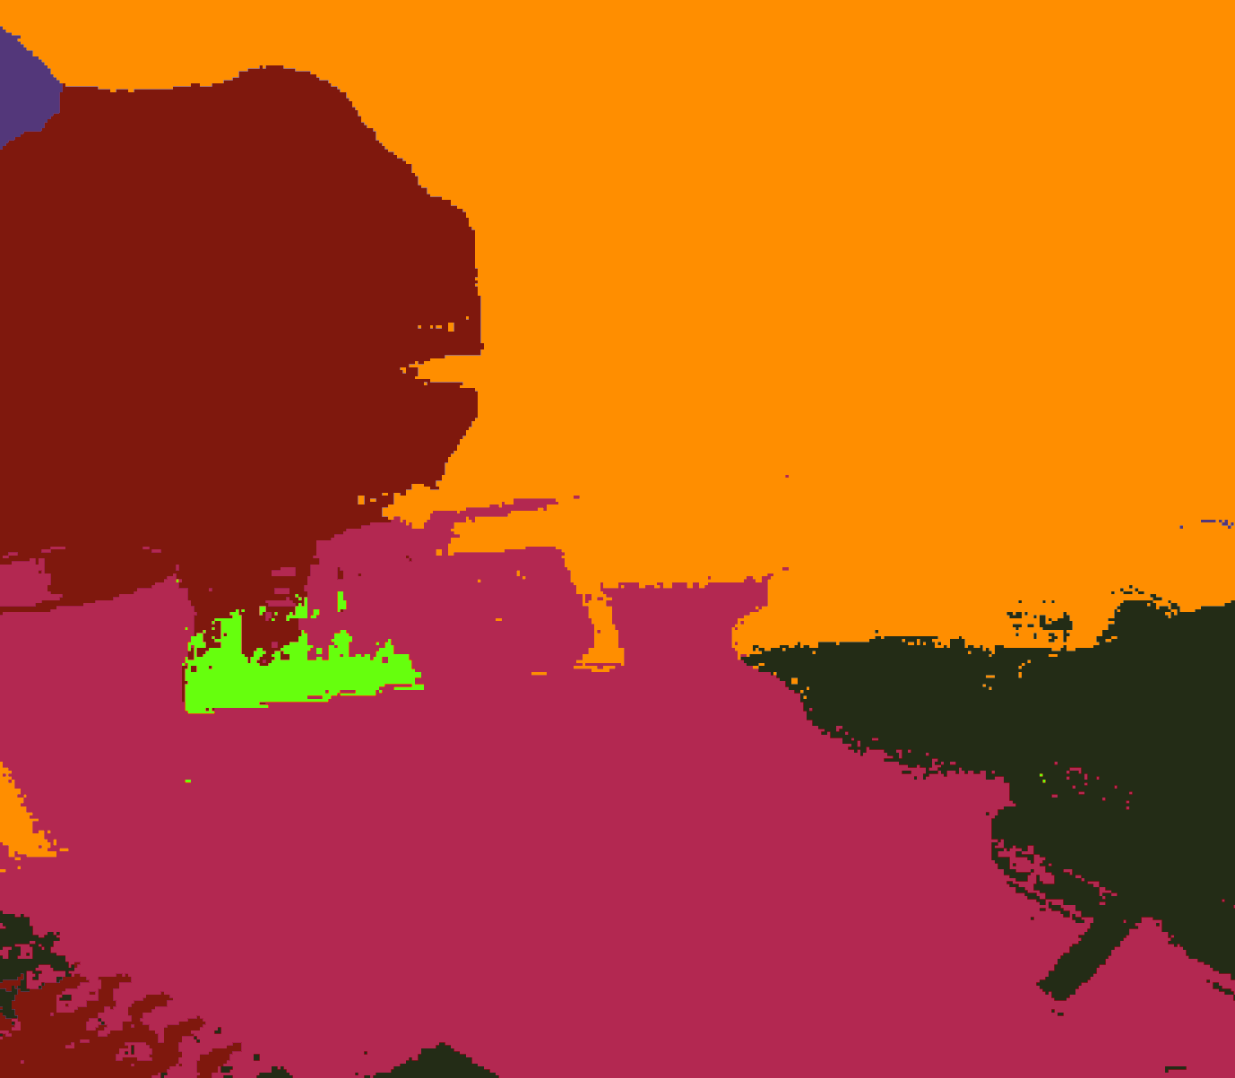
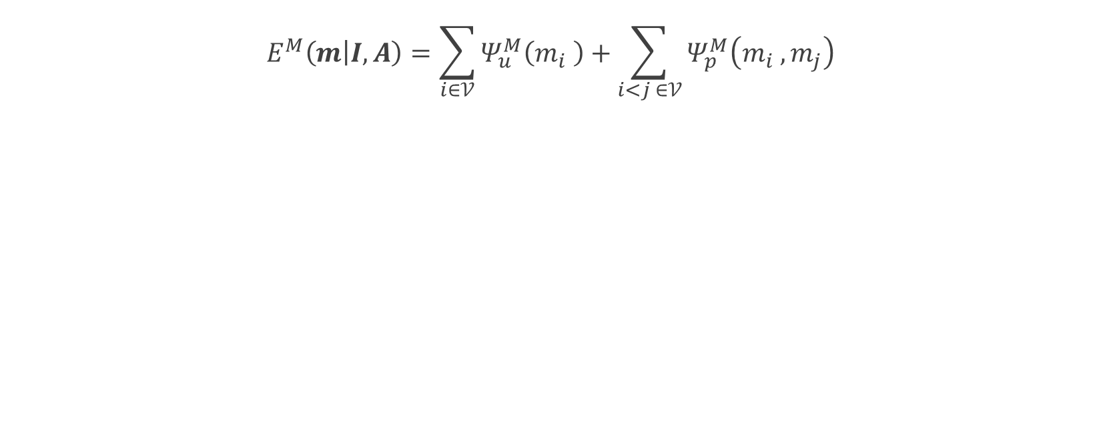
Material Energy
$$E^{M}\left(m | I,A\right)=\sum_{i∈𝒱}{Ψ_{u}^{M}\left(m_{i} \right)+\sum_{i<j ∈𝒱}{Ψ_{p}^{M}\left(m_{i} , m_{j}\right)}}$$
Input
Unary
Unary + Pairwise (No Sound)
Notes:
So here, we can again see that our unary predictions are quite noisy. We are only showing the unary predictions from our visual classifier.
And when we add the pairwise potentials, the output is much smoother, although the mug and plastic parts such as keyboard and telephone are still misclassified.

Slide 22

Material Energy
$$E^{M}\left(m | I,A\right)=\sum_{i∈𝒱}{Ψ_{u}^{M}\left(m_{i} \right)+\sum_{i<j ∈𝒱}{Ψ_{p}^{M}\left(m_{i} , m_{j}\right)}}$$
Input
Unary
Unary + Pairwise (No Sound)
Unary + Pairwise (With Sound)
Notes:
Our labelling improves when we use sound information in our unary potentials.
The yellow boxes in the input image show where the objects were struck and consequently, where in the image we have auditory information.
Since all of these sounds were classified correctly, our overall material labelling improves considerably with the mug, keyboard and telephone being correctly labelled now.
The keyboard just beneath the monitor does not have sound associated with it – but it still classified correctly when we add sound. The reason for this is due to the long-range interactions that we incorporate into our CRF (since all nodes are connected to each other). The pixels from the telephone and second keyboard encourage the first keyboard to take on the same material label as they have similar colour.
Hence, although our auditory information is available for a very sparse set of pixels, we can propagate it throughout the image using visual cues.

Slide 23



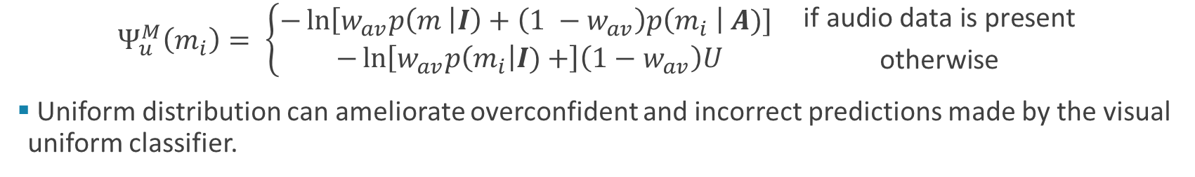
Material Energy
$$Ψ_{u}^{M}\left(m_{i}\right)= \left\{\begin{aligned}−\ln\left[w_{av}p\left(m \right|I\right)+\left(1 −w_{av}\right)p\left(m_{i} \right| A)] \\ −\ln\left[w_{av}p\left(m_{i}\right|I)+\right]\left(1−w_{av}\right)U\end{aligned}\right. {\text{if} \text{audio} \text{data} \text{is} \text{present} \atop \text{otherwise}}$$
Uniform distribution can ameliorate overconfident and incorrect predictions made by the visual uniform classifier.
Unary + Pairwise (With Sound, but without Uniform Distribution)
Unary + Pairwise (With Sound and Uniform Distribution)
Input
Notes:
Previously, I mentioned that we use a Uniform distribution as the output of our sound classifier when no audio data is available.
It would have been possible, in this case, to just use the output of the visual classifier, and ignore the uniform distribution completely.
However, we found that this does not work well at all, as you can see in the middle image.
This is because our visual classifier often predicts the wrong label with a high confidence, and we cannot really recover from this. So adding the uniform distribution in this case, in effect “weakens” overconfident predictions of the visual classifier.
We would probably not have to do this if the unaries produced by the visual classifier were better, and this may have been the case if we had more training data.

Slide 24
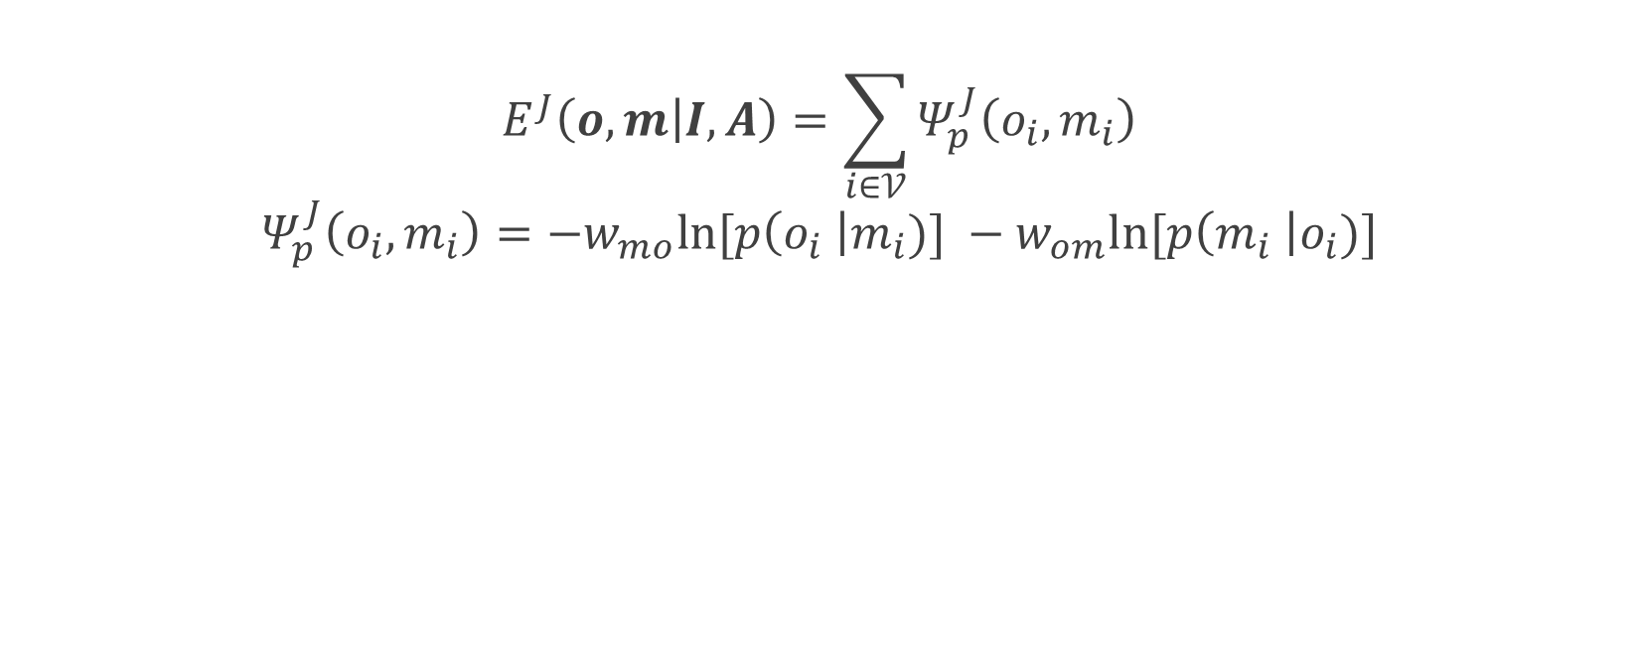
Joint Energy
$$E^{J}\left(o,m | I,A\right)=\sum_{i∈𝒱}{Ψ_{p}^{J}\left(o_{i},m_{i}\right)}$$
$$Ψ_{p}^{J}\left(o_{i},m_{i}\right)=−w_{mo}ln⁡[p\left(o_{i} \right|m_{i})] −w_{om}ln⁡[p\left(m_{i} \right|o_{i})]$$
Cost from material to objects
Cost from object to materials
 | Plastic | Wood | Gypsum | Ceramic | Melamine | Tile | Steel | Cotton | Carpet | Cardboard
Monitor | 0.14255 | 0 | 0 | 0 | 0 | 0 | 0 | 0 | 0 | 0
Keyboard | 0.14239 | 0.000364 | 0 | 0 | 0 | 0 | 0 | 0 | 0 | 0
Telephone | 0.14255 | 0 | 0 | 0 | 0 | 0 | 0 | 0 | 0 | 0
Desk | 0.002764 | 0.31946 | 0.000344 | 0 | 0 | 0 | 1.93E-05 | 0 | 0 | 0
Wall | 1.48E-08 | 0 | 0.98864 | 0 | 0 | 0 | 0 | 0 | 0 | 0
Chair | 0 | 0 | 0 | 0 | 0 | 0 | 0 | 0.5 | 0 | 0
Mug | 0 | 0 | 0 | 1 | 0 | 0 | 1.60E-05 | 0 | 0 | 0
Whiteboard | 0 | 0 | 0 | 0 | 1 | 0 | 0 | 0 | 0 | 0
Tile | 0 | 0 | 0.003877 | 0 | 0 | 1 | 0 | 0 | 0 | 0.00287
Mouse | 0.14255 | 0 | 0 | 0 | 0 | 0 | 0 | 0 | 0 | 0
Cupboard | 0.000103 | 0.32329 | 0.004149 | 0 | 0 | 0 | 0 | 0 | 0 | 0
Kettle | 0.14255 | 0 | 0 | 0 | 0 | 0 | 0 | 0 | 0 | 0
Fridge | 0.142 | 1.80E-05 | 0.001212 | 0 | 0 | 0 | 0 | 0 | 0.002535 | 0
Sink | 0 | 0.030783 | 0 | 0 | 0 | 0 | 0.99996 | 0 | 0 | 0
Microwave | 0.14226 | 0 | 0 | 0 | 0 | 0 | 0 | 0 | 0 | 0
Couch | 0 | 0 | 0 | 0 | 0 | 0 | 0 | 0.5 | 0 | 0
Floor | 4.34E-05 | 0 | 1.36E-05 | 0 | 0 | 0 | 0 | 0 | 0.99746 | 0
Hardcover Book | 0 | 0.00016 | 0 | 0 | 0 | 0 | 0 | 0 | 0 | 0.99779
Shelf | 0 | 0.3259 | 0 | 0 | 0 | 0 | 0 | 0 | 0 | 0
Notes:
The joint energy encourages consistency between material and objects.
We learn the costs from the training data, by estimating the conditional probability of object given material and vice versa by counting coocurrences in the training data.
Objects and material which do not co-occur in the training data (such as a mug made of gypsum) have a very low probability, and consequently high cost which discourages that label pair from being selected at all.

Slide 25

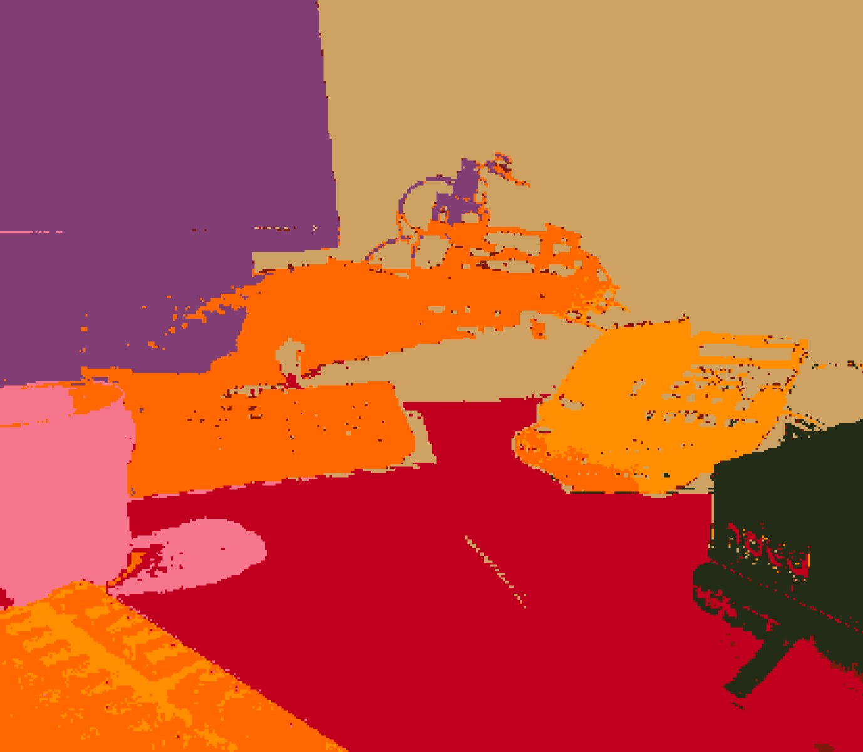
Joint Energy
Objects
Materials
Without any joint optimisation
With joint optimisation
Notes:
So this example shows how the joint energy costs improves our object labelling, since our knowledge of the material labelling is used to improve our objects.
For example, we can now correctly label the mug, since we know from our training data that a wall made of ceramic is highly unlikely.
In our case, we did not really observe object labelling improving the material labelling though.

Slide 26
Results – Sound Classification
Material | Plastic | Wood | Gypsum | Ceramic | Melamine | Tile | Steel | Cotton | Average
Accuracy (%) | 73.61 | 100 | 16.67 | 100 | 33.33 | 14.29 | 11.11 | 0 | 67.11
F1-Score (%) | 82.81 | 59.52 | 16.67 | 97.30 | 42.86 | 20 | 20 | 0 | 42.39
Plastic, wood and ceramic are classified easily
Materials like cotton hardly produce any sound
Sound transmission impedes recognition
Eg Tile affixed to a wall sounds like a wall
Notes:
So now we look at our actual results:
Our sound classification worked well for particular material classes, such as plastic wood and ceramic, since these materials have more distinctive sounds.
Materials such as cotton hardly produce a sound which is why their accuracy is so low.
We also observed the adverse effect that sound transmission has on recognition: For example, knocking a tile affixed to a wall causes the resultant pressure waves in the tile to propagate through the wall. The end result is a sound wave that sounds similar to the wall and distinct from the sound of knocking a tile placed on a wooden table. Striking a melamine whiteboard that is affixed to a wall produces the same effect.

Slide 27
Results – Semantic Segmentation
 | Weighted Mean IoU |  | Mean IoU |  | Accuracy (%) |  | Mean F1-Score
 | Object | Material | Object | Material | Object | Material | Object | Material
Visual Features (unary) | 31.51 | 38.97 | 10.16 | 16.71 | 49.89 | 58.46 | 15.54 | 25.00
Visual Features (unary and pairwise) [1] | 32.54 | 40.20 | 10.69 | 17.09 | 52.19 | 60.81 | 16.06 | 25.28
Visual features (unary and pairwise) | 32.64 | 41.06 | 10.88 | 17.65 | 52.84 | 62.46 | 16.15 | 25.91
Audio-visual features (unary and pairwise) | - | 44.54 | - | 21.83 | - | 66.45 | - | 31.49
Visual features only, joint optimisation | 34.40 | 41.06 | 11.15 | 17.65 | 53.63 | 62.46 | 17.19 | 25.91
Audio-visual features, joint optimisation | 36.79 | 44.54 | 12.80 | 21.83 | 55.65 | 66.45 | 19.59 | 31.49
[1] Ladicky, 2009
Notes:
These are the results from our semantic segmentation.
The performance basically increases as we add terms to the energy function of our CRF.
We could not really compare our results to anyone, since we created this dataset.
Nevertheless, we use the CRF implementation of Ladicky as a baseline in the second row, and show that we do outperform that.

Slide 28
Conclusions and Future Work
Complementary sensory modalities can be used to improve classification performance
CRF model can use sparse auditory information effectively to augment existing visual data
Dataset is publicly available - www.robots.ox.ac.uk/~tvg/projects/AudioVisual/
Implement this system on a robot
Combine more sensory modalities.
Notes:
In conclusion, we showed how complementary sensory modalities can be used to improve classification performance.
In particular, our CRF model can effectively use sparse auditory information to augment existing visual data.
We created a new dataset for our work, and since it is publicly available, we hope that it encourages more work in audio-visual computer vision.
In terms of further work, we could explore other sensory modalities in addition to sound. And we hope to implement our system on a mobile robot which will use its arm to tap objects and learn about them.

